Slide 1

NDMA CUAS Specialist Course - Introduction

Slide 2
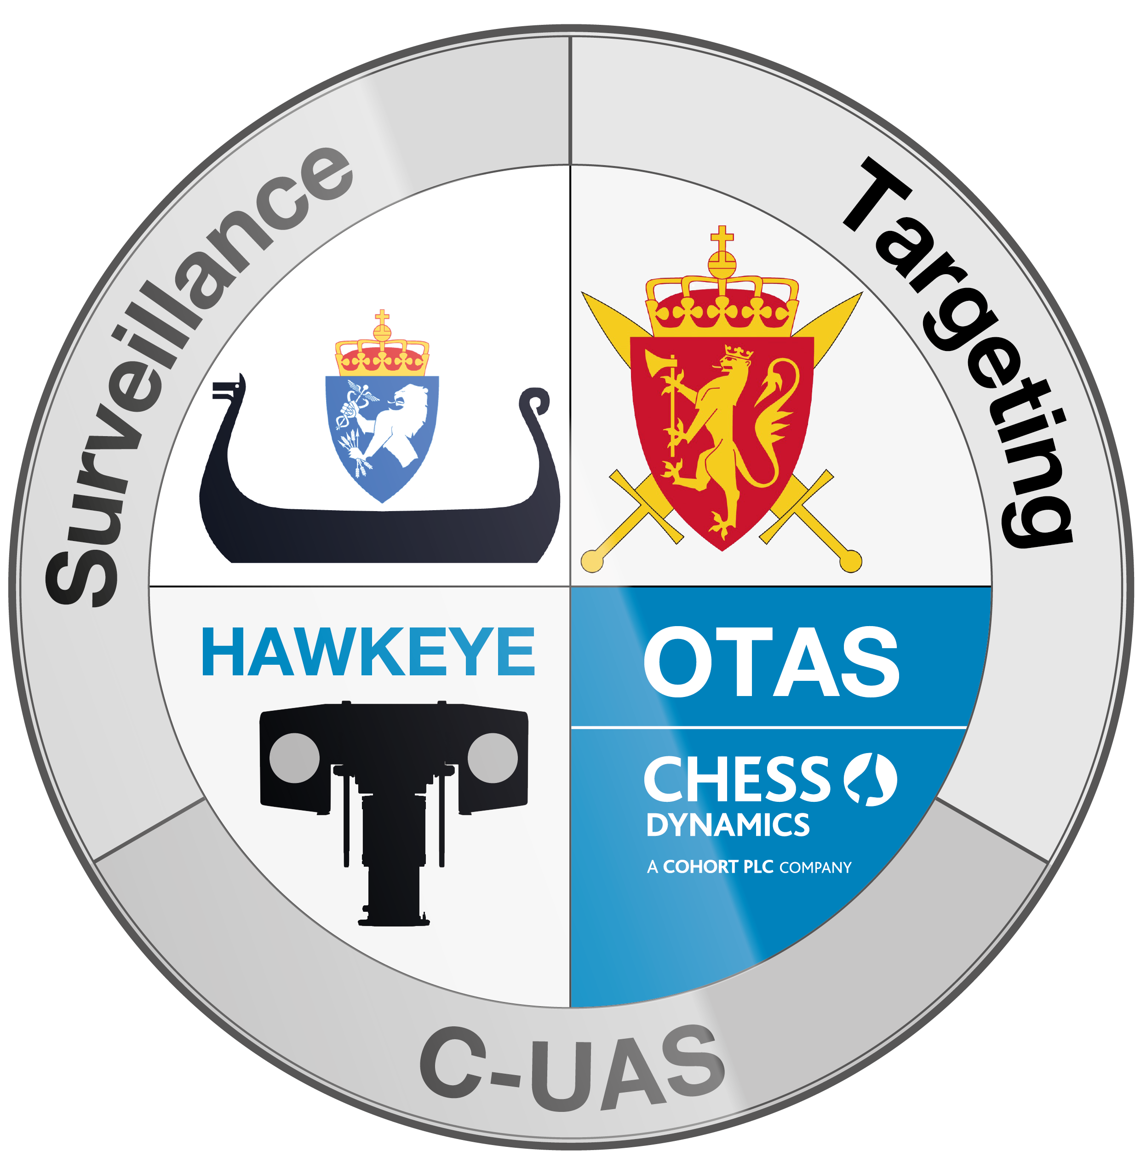
Back Ground
Trainer: Phill Griffin
Who am I?
I have Worked for Chess for over 8 years. I am the Lead Service Engineer.
Involved with NDMA for approximately 4 years covering all systems deployed in Norway.
In depth Knowledge of the CUAS system
Worked on a wide variety of Land and Naval systems
SW Support: Richard Myers
SW Group Leader
  Worked extensively on the development of the Chess C2 system
  Integration of additional sensors
Field Service Engineer: Jack Goble
Has worked on C-UAS for integration and testing
Worked across other platforms supplied to NDMA

Slide 3
Course Aims and Objectives
  Provide a more in depth view of the system
  Impart information on Container Safety, operation and setup.
  To make you competent in replacement of LRU’s.
  To be able to configure the system upon new deployment.
How?
  We aim to meet these objectives through Class room presentations and hands on practical activities with the physical system.
  Happy for questions throughout the training.
End Goal:
To provide indepth system information to enable you to diagnose faults, replace system components and to setup the containers on initial deployment.

Slide 4
Training Schedule – TO BE UPDATED

Slide 5
Section Information

Slide 6
Blank Slide Template - Slide Title
Additional Information

